Slide 1



Welcome to week 7!
^{MACHINE LEARNING II:}
^{Artificial Neural Networks}
^{and Deep Learning.}
^{DÉBORA CORRÊA and} ^{AYHAM ZAITOUNY}
^{30 OCT 2018}

Slide 2
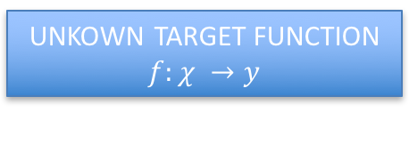
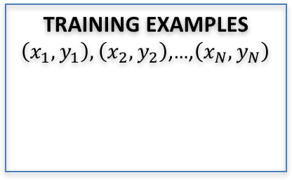
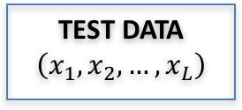

Last week…
UNKOWN TARGET FUNCTION
$$f:χ →y$$
(e.g. ideal formula to predict when to replace a component)
TEST DATA
$$\left(x_{1},x_{2},…,x_{L}\right)$$
STUDY THE
PROBLEM
Random
Forest
K-NN
SVM
TRAINING EXAMPLES $\left(x_{1},y_{1}\right),\left(x_{2},y_{2}\right)$,…,$\left(x_{N},y_{N}\right)$
LEARNING
ALGORITHM
EVALUATE
APPLY
SOLUTION
$$\hat{f}≈f$$
(e.g. learned maintenance prediction formula)
(e.g. historical records of maintenance)
ANALYZE
ERRORS
Precision
Recall
F1-score
Confusion matrix
Measures for
Imbalanced datasets
Today:
Neural networks and
deep learning.
Picture adapted from: Hands on Machine Learning with Scikit-Learn and TensorFlow, Cap 1.

Slide 3
PLAN OF THE DAY:
Introduction to Artificial Neural Networks (ANNs)
Types of ANNs
MLPs and activation functions
Practice
Morning
Multilayer Perceptrons
Regularization
Python notebook using MLPs to classify images.
Late morning
Convolutional Neural Networks.
Python notebook using CNNs to classify images.
Discussion CNNs vs deep MLPs.
After lunch
Recurrent Neural Networks.
Python notebook using RNNs for time series prediction.
Takeaways
Late afternoon

Slide 4
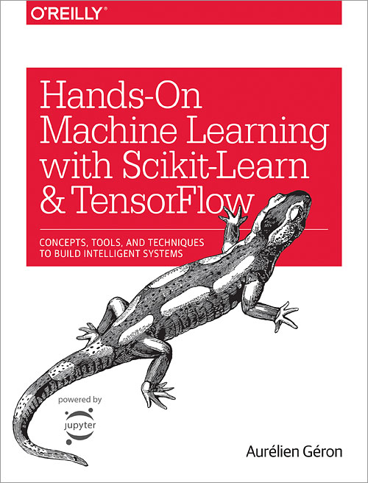
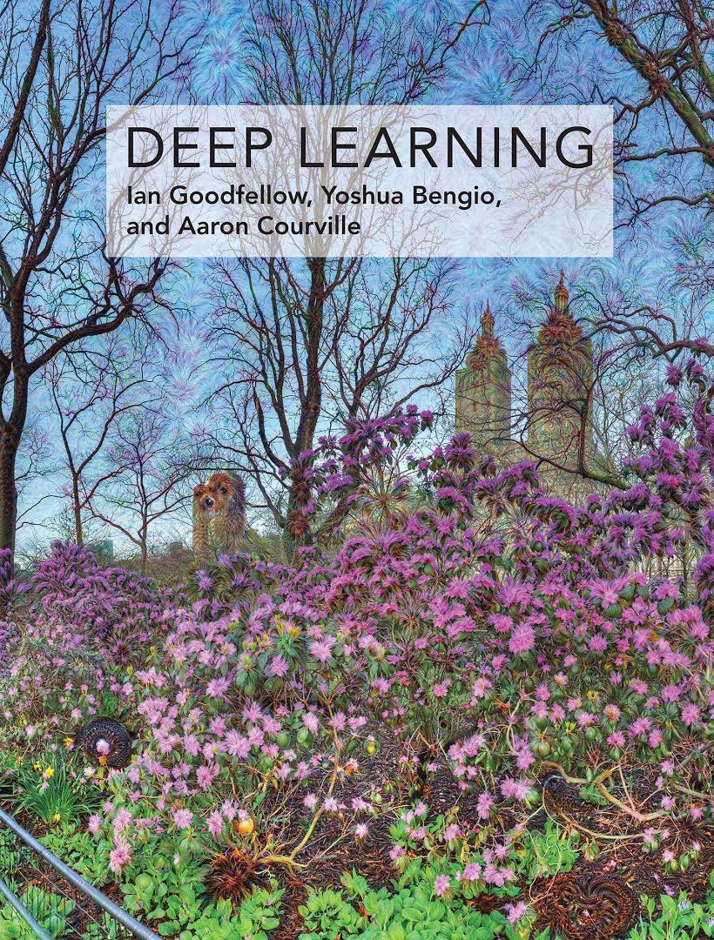
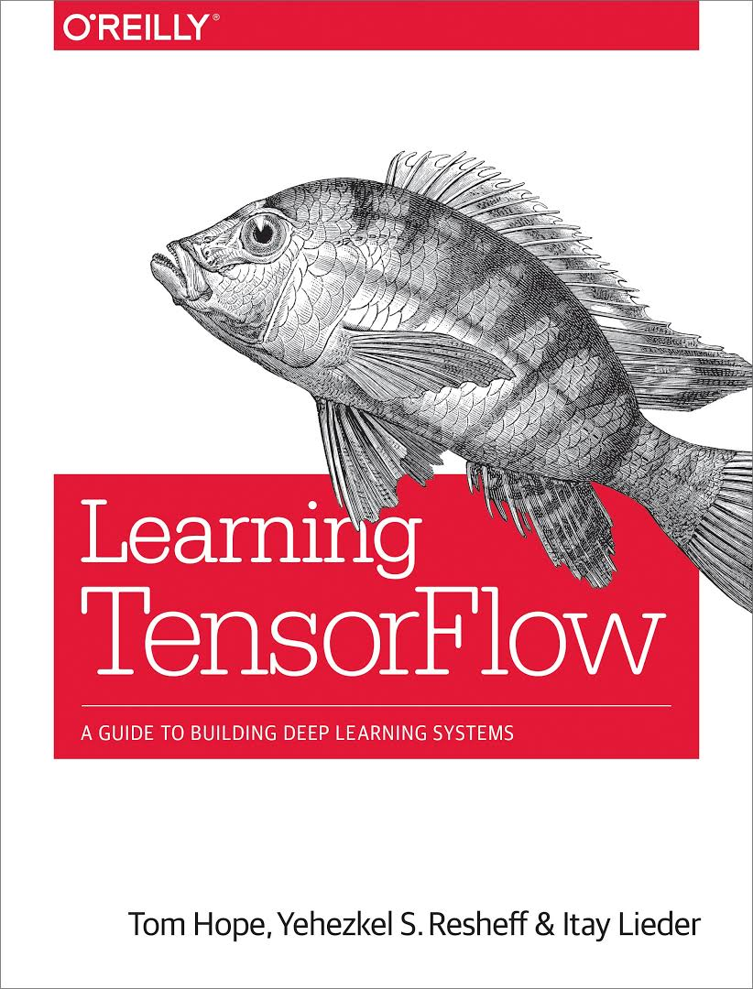
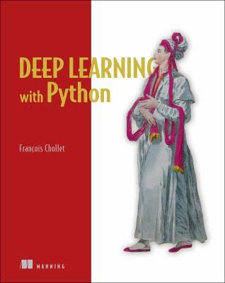
Suggested references
Scikit-learn: http://scikit-learn.org
TensorFlow: https://www.tensorflow.org
Andrew Ng deep learning page: https://www.deeplearning.ai
Get prepared:
https://github.com/core-skills/07-machine-learning
Environment on Windows: environment_win.yml
Environment on Mac: environment_mac.yml

Slide 5
DATA FUSION AND MACHINE LEARNING II:
Introduction to Artificial Neural Networks
DÉBORA CORRÊA AND AYHAM ZAITOUNY
^{30 OCT 2018}

Slide 6
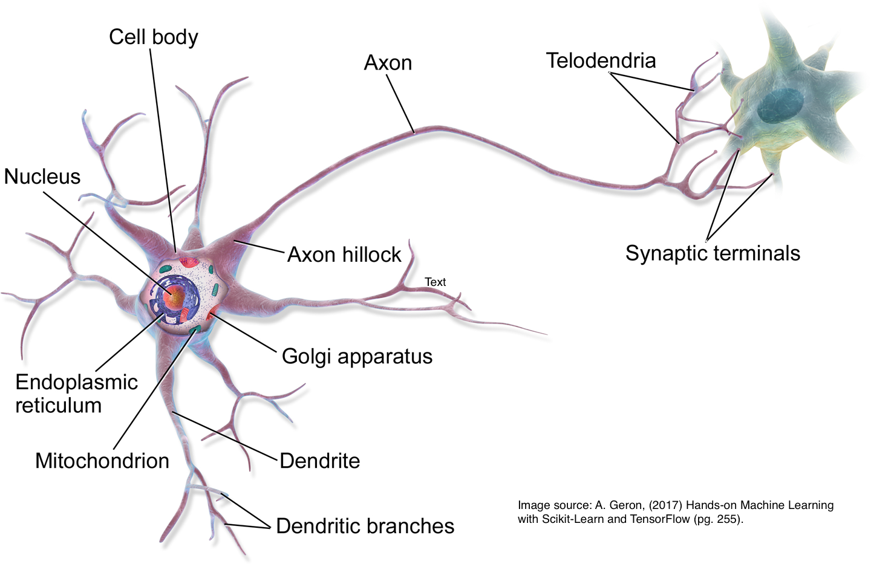
ANNs: NEURO-INSPIRED COMPUTATION
Artificial neural networks (ANNs): family of models with a gross inspiration from the brain:
Excellent pattern recognition models.
Excellent on unstructured data.
Biological neuron
Artificial neuron
Our brain: about 86 billion neurons¹.
Largest ANN: about million neurons².
1 https://www.nature.com/scitable/blog/brain-metrics/
2 https://phys.org/2018-06-ai-method-power-artificial-neural.html

Slide 7
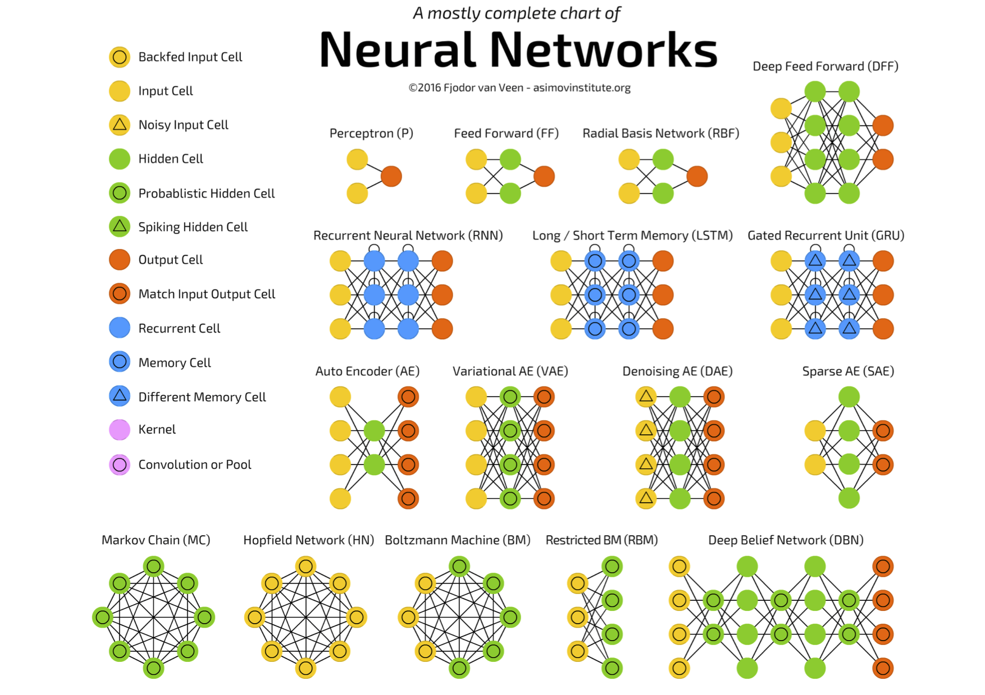
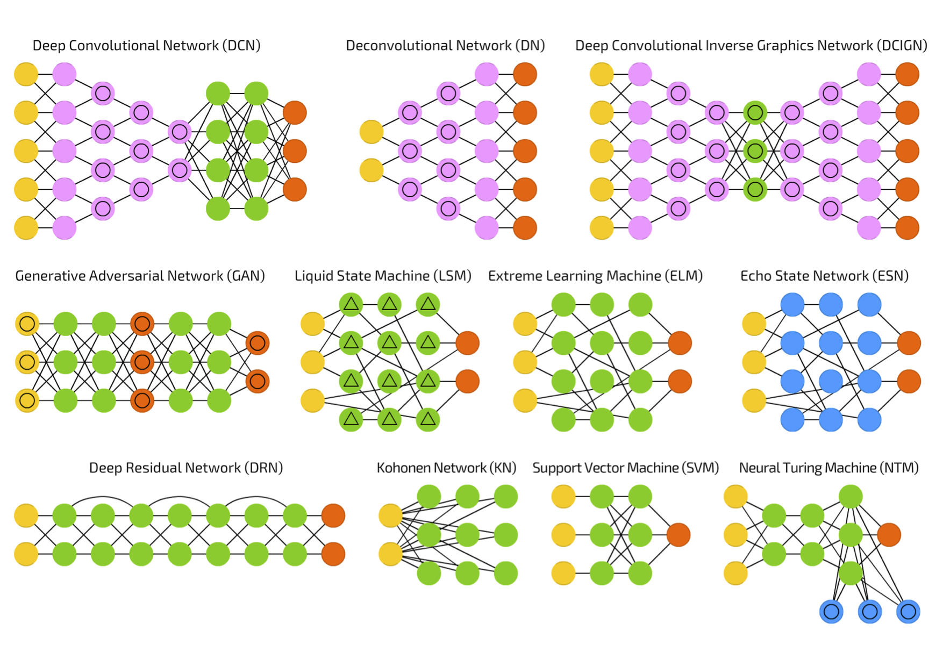
ANNs AND THEIR FLAVORS
ANNs are general function approximators and perform well when learning a complex mapping from the input to the output space.
What the network should capture in order to perform such mapping?
What should be the input and the output?
Chart available at: https://towardsdatascience.com/the-mostly-complete-chart-of-neural-networks-explained-3fb6f2367464

Slide 8
ANNs AND APPLICATIONS
Structured data
Multilayer Perceptrons
Input: features, database of data
Classification, regression.
Image data
Convolutional Neural Networks
Input: images
Classification (objects, face, scene, action, etc.)
Sequence data
Recurrent Neural Networks
Input: time series, audio, text
Classification, speech recognition, prediction.
Different types of data
Autoencoders
Input: original data representation
Dimensionality reduction, pre-training, data reconstruction.
Combination of different ANNs is also very common.

Slide 9
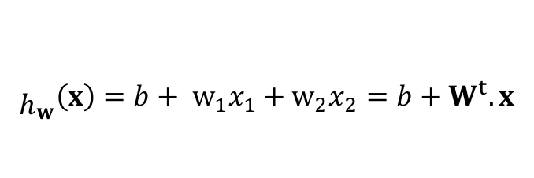
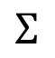
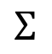
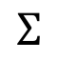
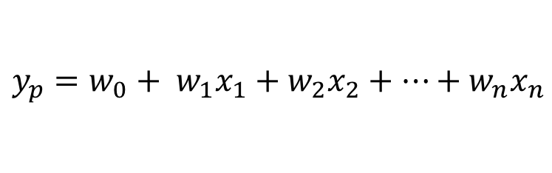
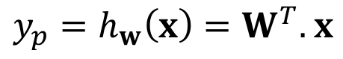
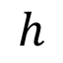
LINEAR MODELS
Linear regression
$$y_{p}=w_{0}+ w_{1}x_{1}+w_{2}x_{2}+…+w_{n}x_{n}$$
$y_{p}=h_{w}\left(x\right)=W^{T}.$ $x$
$${\begin{aligned} \\ h\end{aligned}}_{w}\left(x\right)=b+ w_{1}x_{1}+w_{2}x_{2}={b+W}^{t}.x$$
$$Σ$$
$$h$$
$$Σ$$
$$Σ$$
$$Σ$$
bias
b
1
w₁
w₂
weights
1
$$Σ$$
$$Σ$$
$$Σ$$
x₁
x₂
Input features
1
x₁
x₂
How to include nonlinearity?
Stack layers with intermediary values?
But, it is still a linear model!
Outputs are linear combination of inputs.

Slide 10
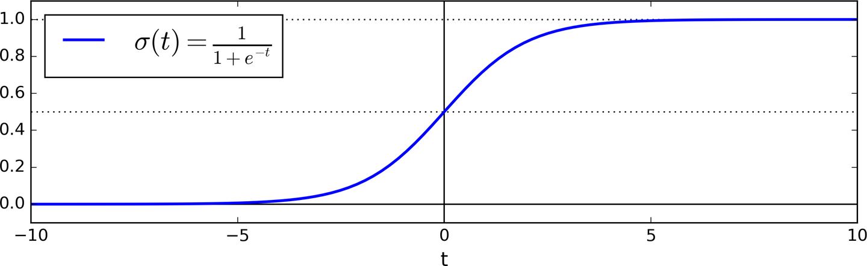
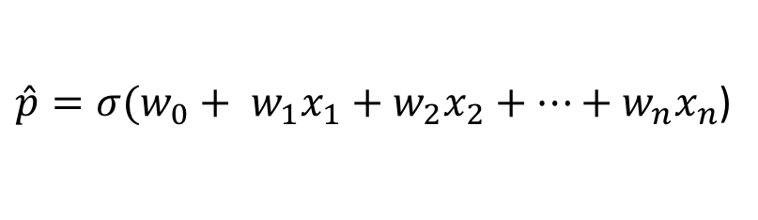
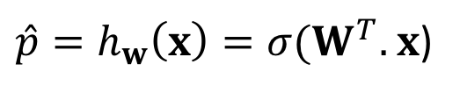
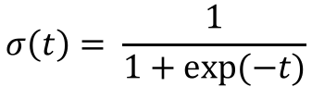
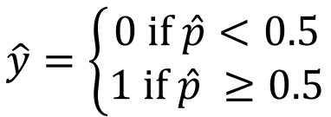
LOGISTIC REGRESSION
Similar to Liner Regression: the model computes a weighted sum of the input features and add a bias term.
Output: Logistic function applied on the resulting sum.
Logistic regression
$\hat{p}={σ(w}_{0}+ w_{1}x_{1}+w_{2}x_{2}+…+w_{n}x_{n}$)
$\hat{p}=h_{w}\left(x\right)={σ(W}^{T}.$ $x$)
$$\hat{y}=\left\{\begin{aligned}0 if \hat{p}<0.5 \\ 1 if \hat{p} ≥0.5\end{aligned}\right.$$
$$σ\left(t\right)= \frac{1}{1+exp⁡(−t)}$$
predicted class
ANNs follow the same idea:
we transform the output of a neuron using nonlinear transformation.

Slide 11
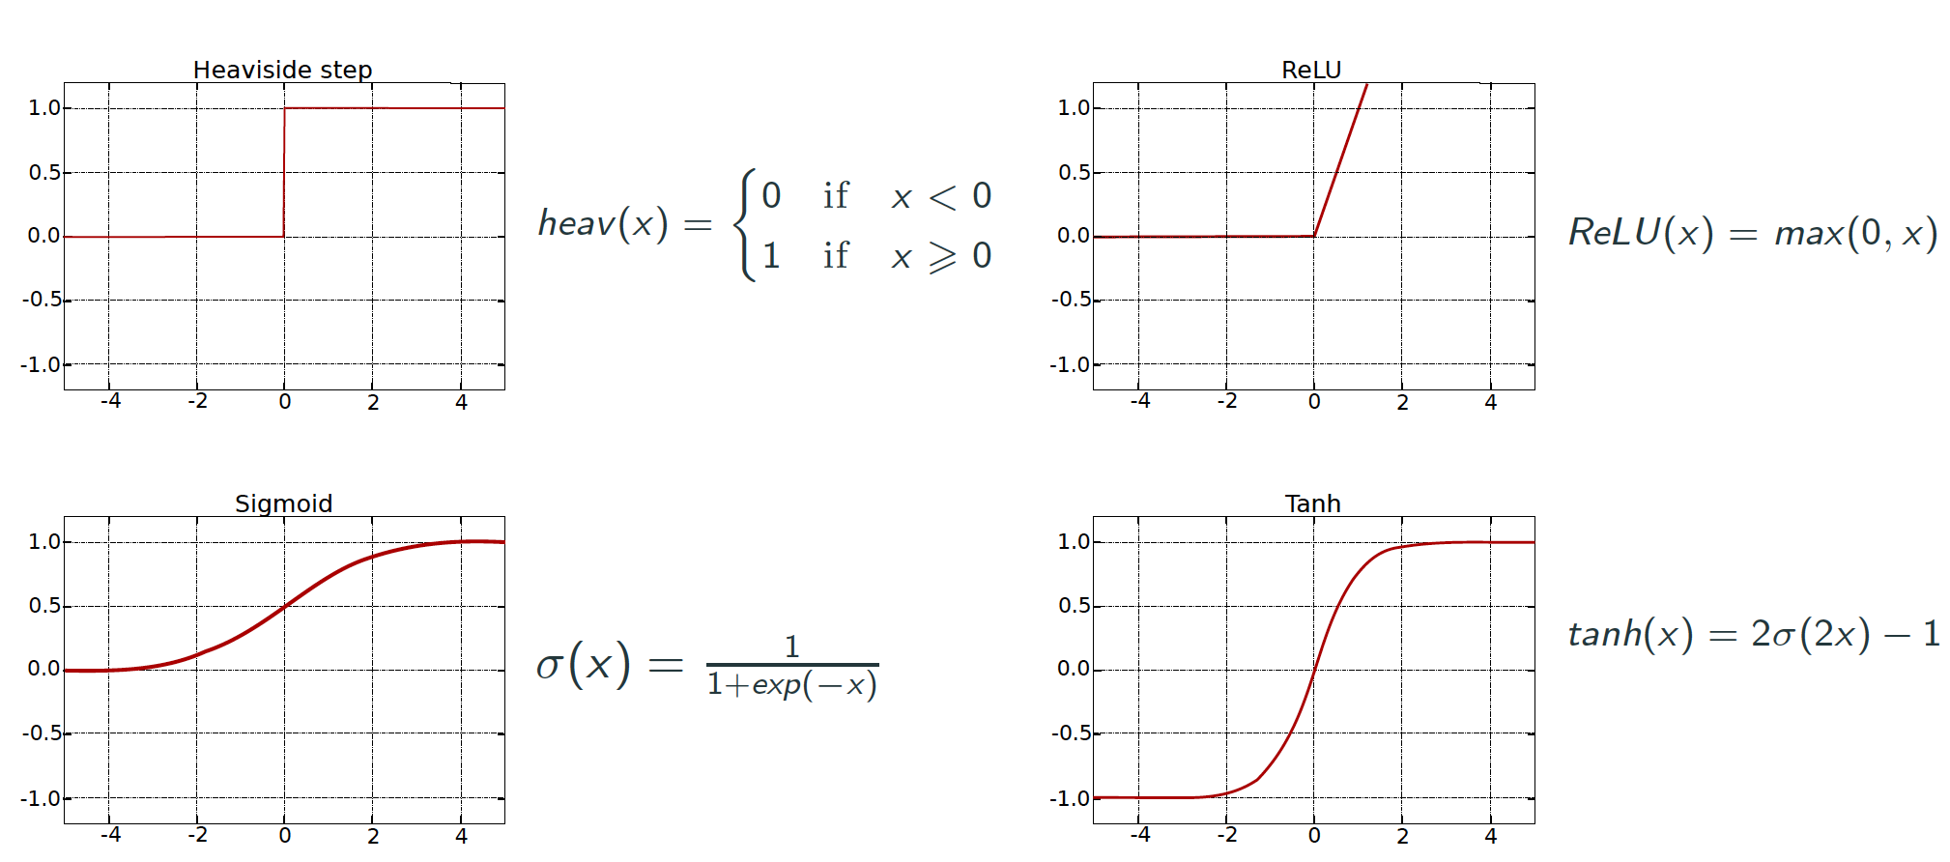
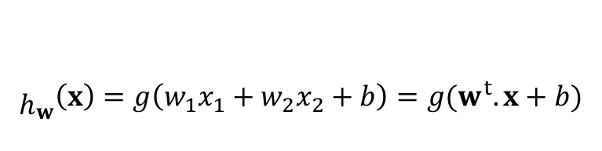
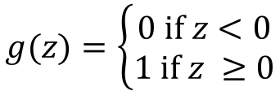
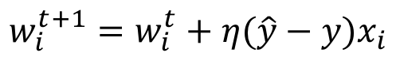
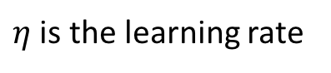
PERCEPTRON
Linear Threshold Units (LTUs)
$${\begin{aligned} \\ h\end{aligned}}_{w}\left(x\right)=g\left(w_{1}x_{1}+w_{2}x_{2}+b\right)=g(w^{t}.x+b)$$
$$g(z)=\left\{\begin{aligned}0 if z<0 \\ 1 if z ≥0\end{aligned}\right.$$
output
g
$$Σ$$
LTU
bias
b
1
w₁
w₂
weights
input layer
x₁
x₂
Perceptron learning rule (weight update)
The weights and bias are the
parameters to be learned!
$$w_{i}^{t+1}=w_{i}^{t}+η(\hat{y}−y)x_{i}$$
$η$ is the learning rate
Source: Hands on Machine Learning with Scikit-Learn and TensorFlow, Cap. 10.

Slide 12
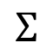
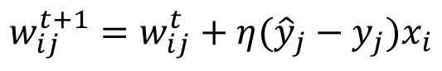
PERCEPTRON
Perceptron can do multiclass classification.
outputs
$$Σ$$
LTUs
$$Σ$$
$$Σ$$
Perceptron learning rule (weight update)
1
$$w_{ij}^{t+1}=w_{ij}^{t}+η({\hat{y}}_{j}−y_{j})x_{i}$$
x₁
x₂
If the classes are linearly separable, Perceptron will converge to a solution:
Perceptron convergence theorem
Source: Hands on Machine Learning with Scikit-Learn and TensorFlow, Cap. 10.

Slide 13
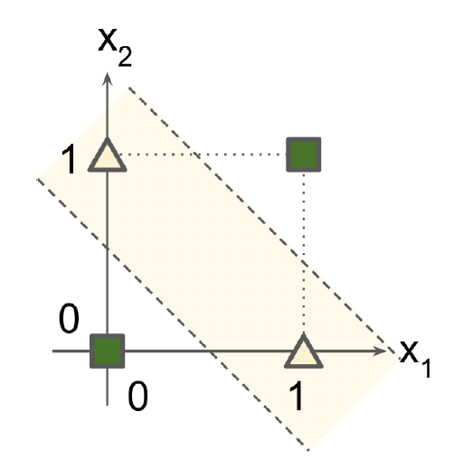
FROM PERCEPTRONS TO MLP
XOR classification problem
output layer
$$Σ$$
-0.5
+1
-1
1
hidden layer
$$Σ$$
$$Σ$$
-1.5
1
-0.5
+1
x₁
x₂
input layer
Perceptron can not solve this!
MultiLayer Perceptron
Source: Hands on Machine Learning with Scikit-Learn and TensorFlow, Cap. 10.

Slide 14
ACTIVATION FUNCTIONS
Idea: Transformation the output of a neuron by a nonlinear function.
Normalization of the output (prevent outputs to explode due to the cascading effect).
This allows neural networks to learn complex patterns and deal with variability in the data.
Decision making at the output of a neuron.

Slide 15
MultiLayer Perceptron
Used for the predictions.
For regression, linear activation
functions can be used, or no activation function at all.
g
g
g
output layer
$$Σ$$
$$Σ$$
$$Σ$$
g
g
g
g
1
hidden layer
Compute complex function by cascading simpler functions.
$$Σ$$
$$Σ$$
$$Σ$$
$$Σ$$
1
input layer
Provides input data to the network.
x₁
x₂
Deep Learning: when an ANN has two or more hidden layers.
Source: Hands on Machine Learning with Scikit-Learn and TensorFlow, Cap. 10.

Slide 16
MultiLayer Perceptron
For exclusive classification
Softmax
softmax
output layer
$$Σ$$
$$Σ$$
$$Σ$$
g
g
g
g
1
hidden layer
$$Σ$$
$$Σ$$
$$Σ$$
$$Σ$$
1
input layer
x₁
x₂
Source: Hands on Machine Learning with Scikit-Learn and TensorFlow, Cap. 10.

Slide 17
PRACTICE
Interactive Google platform for playing with ANNs:
playground.tensorflow.org
Let’s create simple feedforward ANNs and see some effects of
training in real time. ☺

Slide 18
PRACTICE
Part 1: No hidden layers
Select the third dataset.
Train the network using X₁ and X₂.
Select the first dataset.
Do the same: train the network using X₁ and X₂. What happened?
Explore the data structure. It has circular characteristics.
Include the square values of the features, X₁² and X₂², and train the network again. What happened?
Check if these new features can do a good job in the second and fourth datasets.
Explore the data structure of the second dataset. What combination of feature can we use?
Try to use only X₁ and X₂ with a nonlinear activation function.
Include a product of the features, X₁X₂ and do the training again.
Check if you get any good classification performance on the fourth dataset.
What can we observe from these exercises?

Slide 19
PRACTICE
Part 2: Adding hidden layers
Include one hidden layer with one neuron, use only features X₁ and X₂.
Select the second dataset. Do the training using a linear activation function and with a sigmoid or tanh activation function.
Include one neuron in the hidden layer. Do step a) again.
Keep the nonlinear activation function and include one more hidden layers. Does it improve the performance? Does it take long to train?
Repeat some of these steps for a few times to see the effect of the random initialization of the weights.
Select the first dataset.
Do the training using one hidden layer with two neurons (you can use the sigmoid activation function).
Now, include one more neuron in the hidden layer. What happened?
Explore different configurations of hidden layers, number of hidden neuros and activation functions on the datasets.
What can we observe from these exercises?

